Slide 1
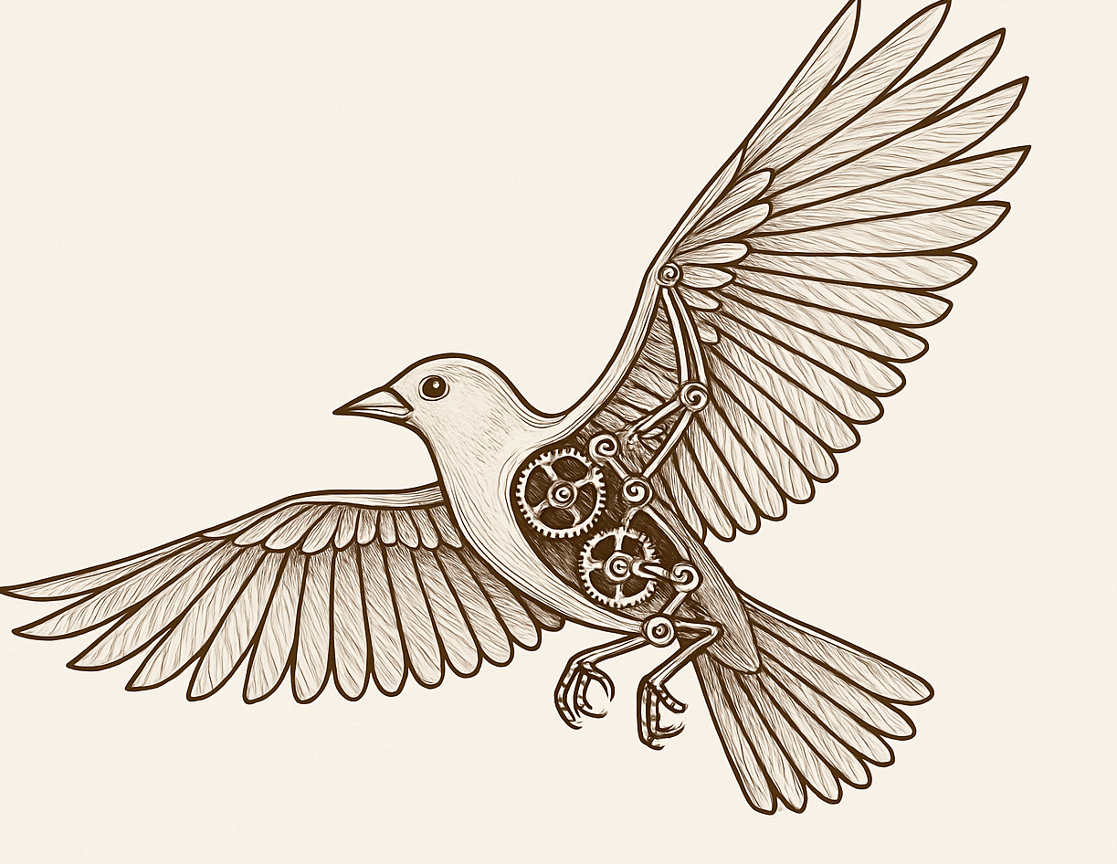

FLYING BIRD MECHANISM
ME 224 Course Project
Department of Mechanical Engineering
Indian Institute of Technology Guwahati

Slide 2

Motivation
The Ornithopter mechanism is inspired by biomimicry—imitating nature to solve engineering problems. Unlike helicopters or airplanes that use rotating blades or fixed wings . Ornithopter flap their wings, like birds or insects.
Why??
Efficient Flight at Small Scale: Traditional propellers don’t work well for tiny flying devices.
Quiet Operation: Flapping is quieter than rotors—useful for stealth .
Agility: Flapping allows quick turns and better control, just like a bird or insect.

Slide 3

APPLICATIONS
Surveillance and Military
1
Miniature flying devices for spying or inspecting in tight or indoor areas.
2
Search & Rescue
Small flapping robots can enter collapsed buildings or hard-to-reach areas.
3
Environmental Monitoring
Monitoring air quality, wildlife, or crops without disturbing ecosystems.
Scientific Research
4
Studying bird or insect flight by creating mechanical versions of them Understanding aerodynamics of flapping wings
Entertainment & Toys
5
Used in robotic bird toys or educational kits to demonstrate flight principles

Slide 4
Kinematic Analysis
Degrees of Freedom (DOF) of the mechanism in your image, we can apply Gruebler’s Equation for planar mechanisms:
DOF = 3(N−1)−2J1−J2
Where:
N = number of links (including the ground),
J1 = number of lower pairs (1-DOF joints, e.g., revolute/prismatic),
J2 = number of higher pairs (2-DOF joints, usually cams or gears here, gear contact counts as a higher pair).

Slide 5
Links (N):
1 ground/base (blue center frame),
2 central cranks (orange vertical links on gears),
4 rocker arms (gray double linkages on both sides),
2 wing extensions (brown outer linkages),
2 spur gears (they rotate, so counted as separate links).
Total: N=11 Higher pairs (J2):
1 gear pair meshing (a higher pair): J2=1
Lower pairs (J1):
Revolute joints between each pair of connected links. From the image:
2 joints on the ground (gear axes),
2 crank-to-gear joints,
4 joints connecting crank to double links (2 per side),
4 joints connecting double links to outer wings,
2 outer joints on the wings. Estimated total revolute joints: J1=14
DOF = 3(11−1)−2(14)−1 = 30−28−1 = 1 Conclusion:
The DOF of this mechanism is 1, meaning it requires only one input motion (e.g., a motor driving one gear) to drive the entire system in a coordinated way. This is ideal for mechanisms like flapping wings, which require synchronized motion.

Slide 6
Kinematic synthesis
Kinematic Synthesis:
The flapping mechanism is designed using kinematic synthesis principles to achieve a realistic bird-like wing motion. The system employs a four-bar linkage driven by a crank-gear pair, ensuring symmetrical and synchronized flapping.
Type Synthesis:
A geared crank-rocker linkage was selected to convert continuous rotary input into oscillatory wing motion. Dimensional Synthesis:
Link lengths and pivot positions were determined to: Achieve desired stroke amplitude. Match natural flapping trajectories. Maintain mechanical advantage across the cycle.
Motion Coordination:
The meshed gears ensure both wings move in phase opposition, replicating biological flapping symmetry.
This synthesis allows for precise control over wing motion, supporting stable, efficient flapping ideal for ornithopter applications.

Slide 7
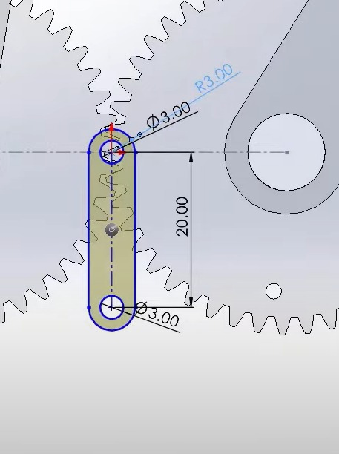
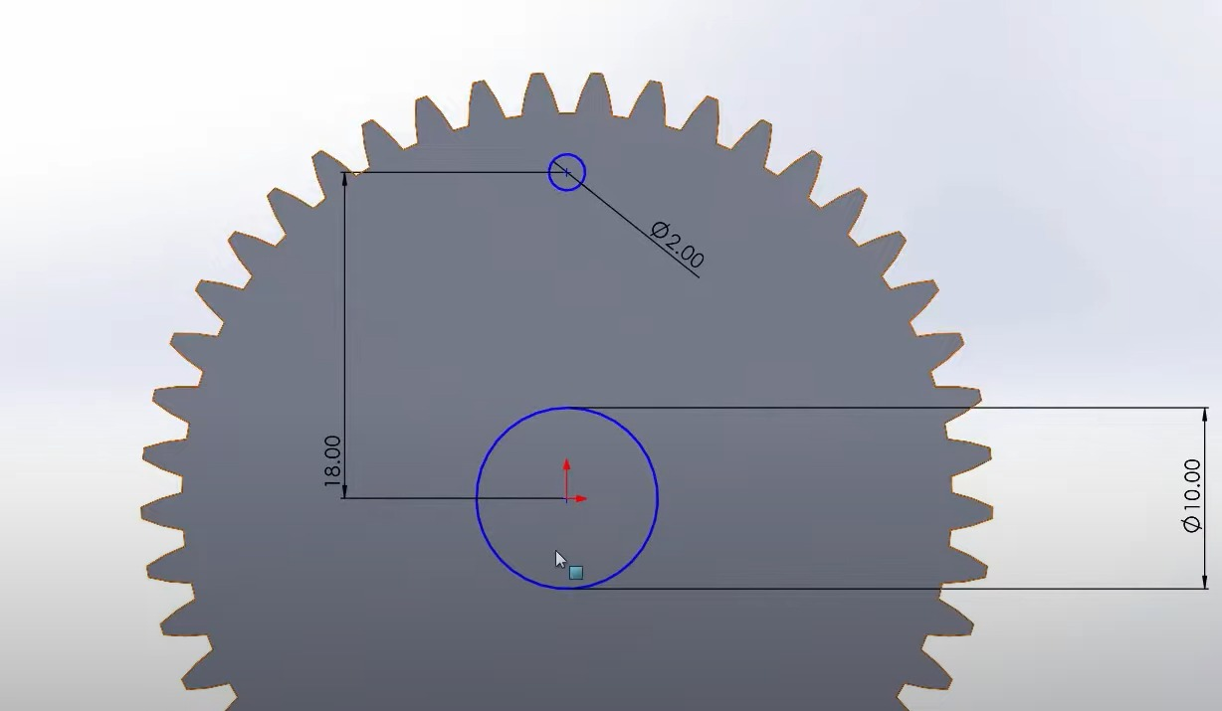
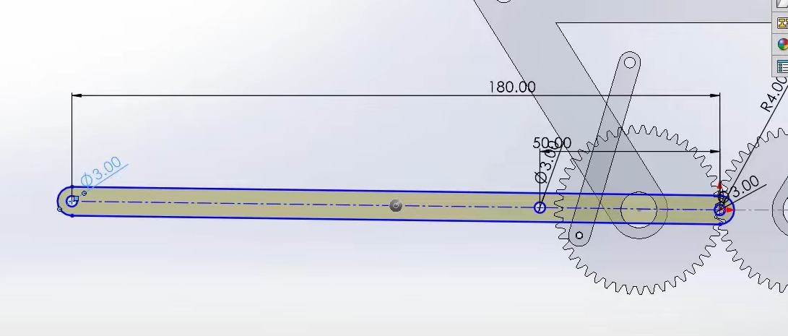
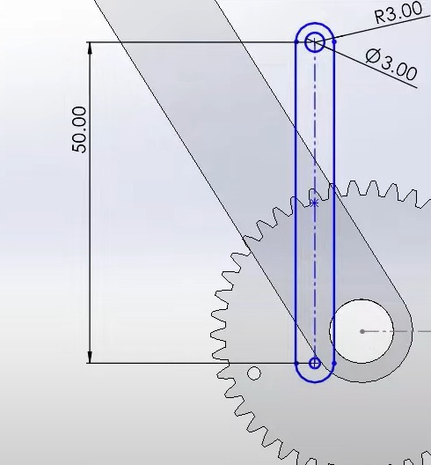
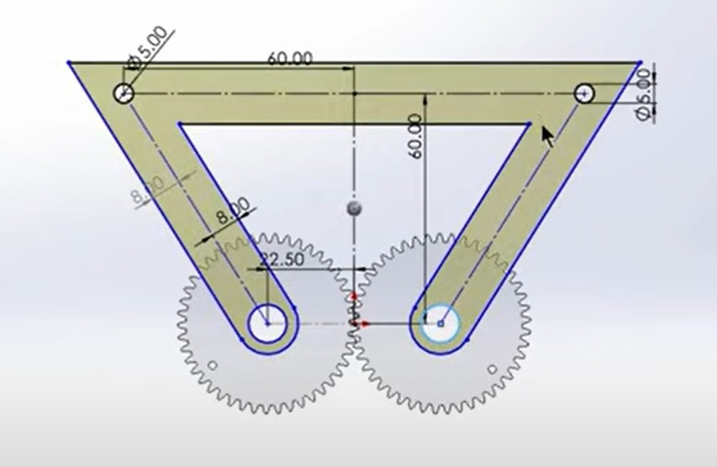
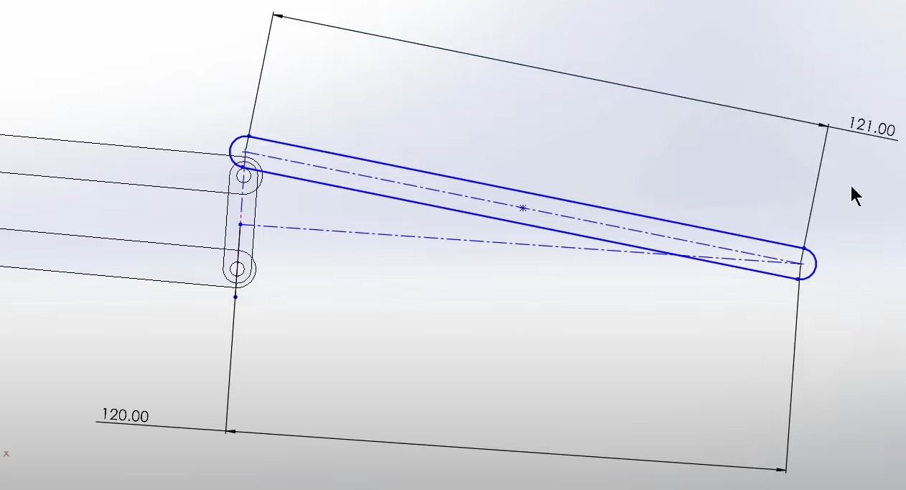

Slide 8
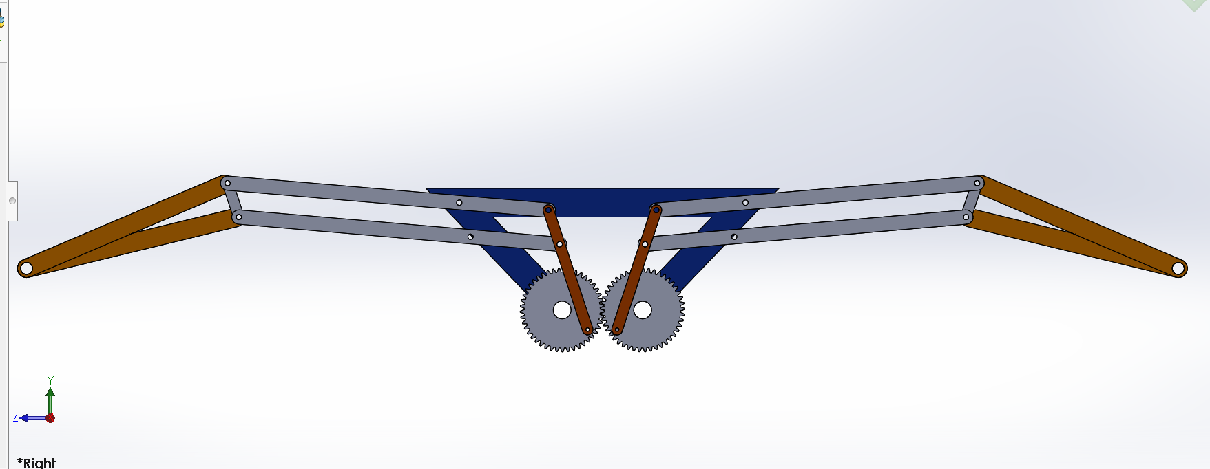
Computer Aided Design
This is the glimpse of our cad file
We have attached our all CAD files with the main assembly in the zip file

Slide 9
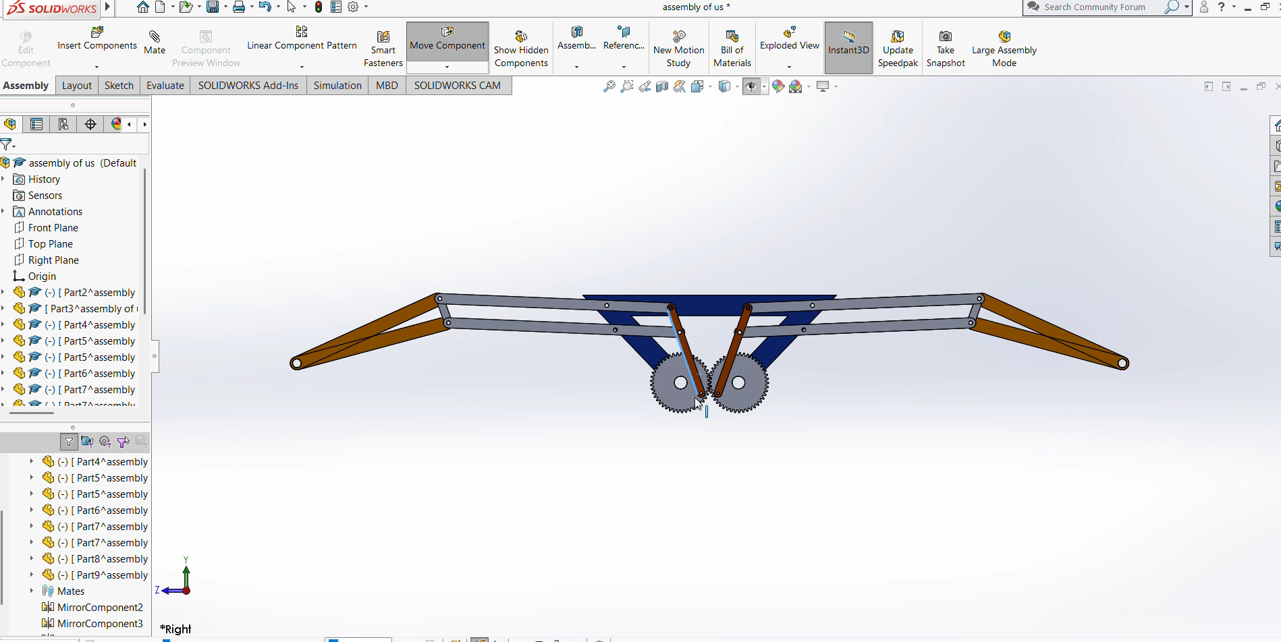
Motion Analysis/Study

Slide 10
1. Actuation
A motor drives one spur gear, which rotates the paired gear (1:1 ratio).
This causes both cranks (orange) to rotate in opposite directions.
2. Crank to Link Motion
Each crank is connected to a double link (gray), forming a 4-bar mechanism.
As the crank rotates, the double link rocks back and forth.
3. Double Link to Wing Link
The motion of the double link drives the wing link (brown), which moves the wings up and down.
4. Wing Flapping
The output is symmetrical flapping motion on both sides.
The flapping amplitude and frequency depend on:
Crank length
Link lengths
Motor speed
5. Type of Motion
Converts rotary motion of motor → oscillating motion of crank → reciprocating flapping of wings.

Slide 11
Fabrication Details
Frame (blue): Aluminum/steel sheet, laser cut​
Gears: Steel/Delrin, same teeth, 1:1 ratio, set screw or press fit​
Cranks (orange): Aluminum/Delrin, 30–50 mm, connects gear to link​
Double Links (gray): Aluminum/carbon rods, 100–150 mm, with spacers​
Wing Links (brown): Aluminum/wood/carbon, 120–180 mm, drives wings​
Joints: Steel bolts/pins, use bearings/bushings, lock with thread-lock​
Motor: DC geared/servo/stepper, mounted on frame, enough torque​
Assembly: Align gears, test crank motion, use spacers, pre-assemble links​v

Slide 12

conclusions
The mechanism successfully mimics bird wing flapping.
Motion is symmetrical and well-coordinated.
Linkage design ensures smooth transmission.
Suitable for bio-inspired flying robots.
Offers scope for further aerodynamic improvements.

Slide 13

Presented by Bellamkonda Deepika Roll no : 230103026 C. Likitha Reddy Roll no : 230103029

